Slide 1
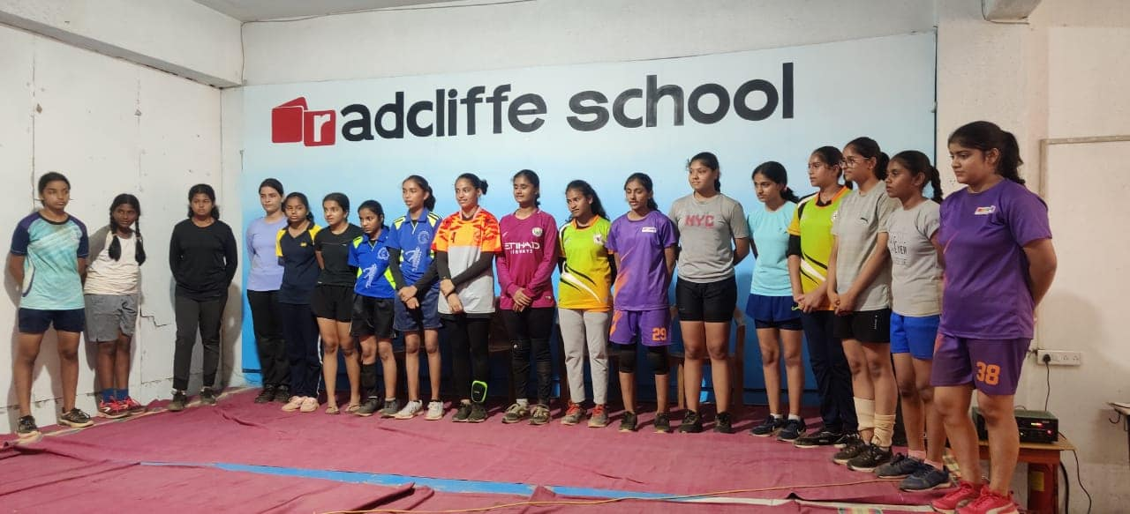
Our coach Ms. Rekha Kamble selected as coach of Maharashtra Girls team for sub junior girls handball National level

Slide 2
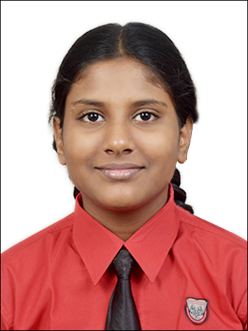
Ms Mihika Gokhale from CP V has been selected for National level handball in the sub junior category. Congratulations Mihika.

Slide 3
Harshil Khanvilkar from Checkpoint III secured the 1st place in Discuss Throw with a 24.6m distance and got selected for the next level of the District level competition.

Slide 4
Ritvika Shukla from CP V received the Best Goalkeeper Handball Tournament of the UTTAR MUMBAI KRIDA MAHOTSAV-2022

Slide 5
U12 Girls team won second place in the Handball Tournament of the UTTAR MUMBAI KRIDA MAHOTSAV-2022 organised by the The Poinsur Gymkhana.

Slide 6
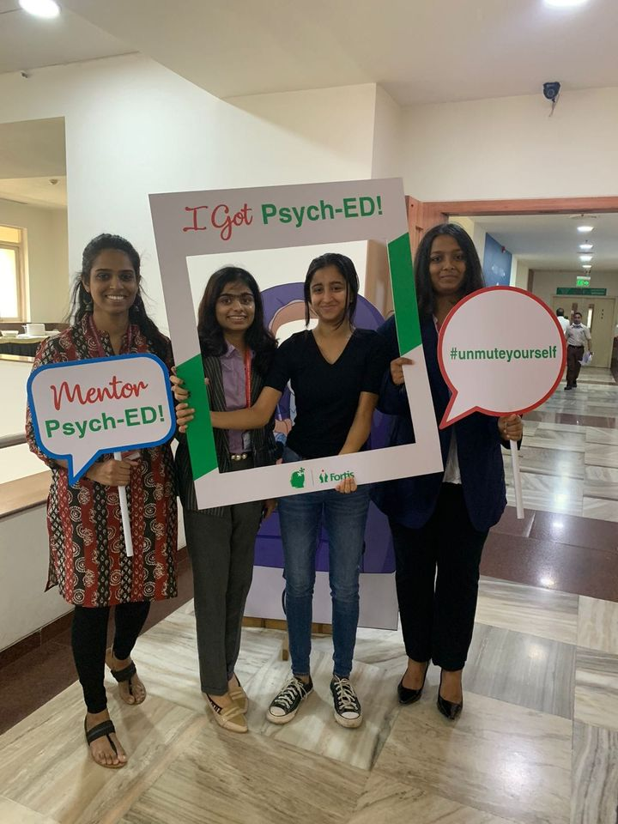
Psychology students of IBDP and AS-AL participated in the "Fortis Mental health Psych-Ed quiz". We had 4 teams for the 1st round. 1 team made it to the zonal round which was held at SL Raheja Fortis Hospital.

Slide 7
Harshil Khanvilkar from Checkpoint III secured the Gold Medal in Discus throw Event with 30.19 m distance in the Athletic Tournament of the UTTAR MUMBAI KRIDA MAHOTSAV-2022 organised by the The Poinsur Gymkhana.

Slide 8
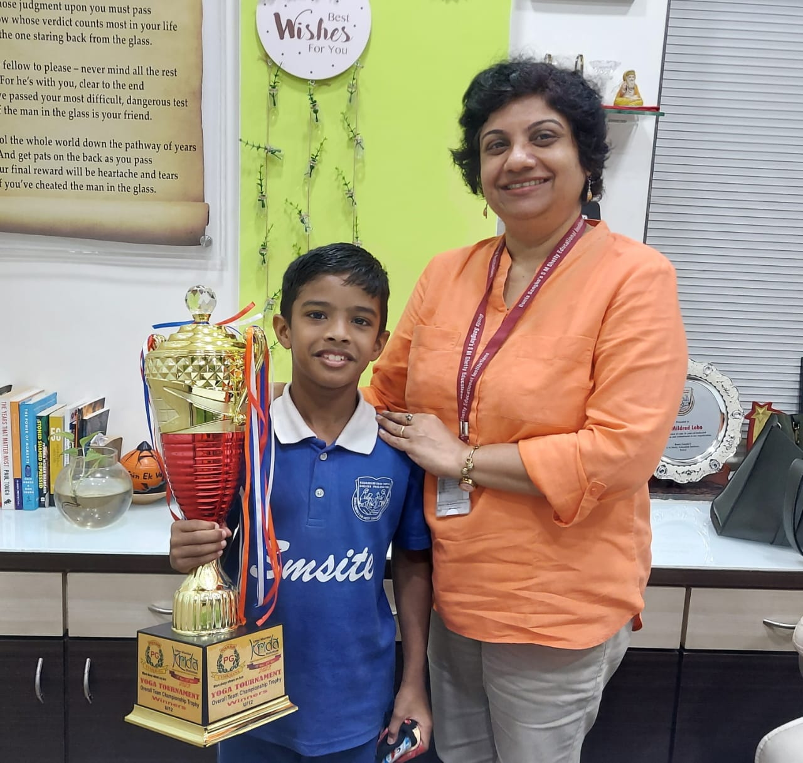
Ayaan Ram from CP III participated in the Yoga Competition at the Poinsur Gymkhana and his team won the trophy for the first place in the competition.

Slide 9
Our team for Web Development ( Atharva Wagh AS Level, Soumya Pandey IBDP II, Viraj Sahu IBDP II and Kayden Moraes AS Level) won the First Prize of Rs 5000/-. of IBDP and A Levels participated in a Techfest organised by Sharanya International School Bangalore

Slide 10
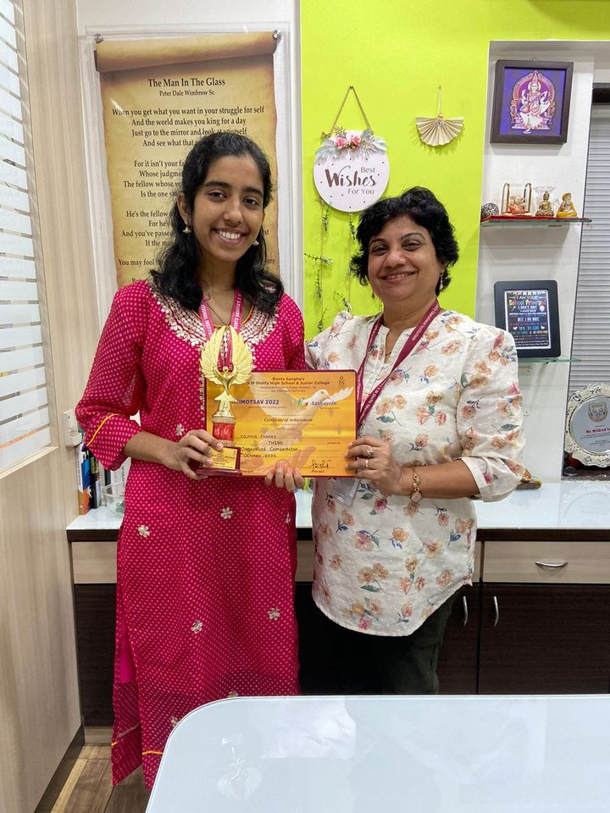
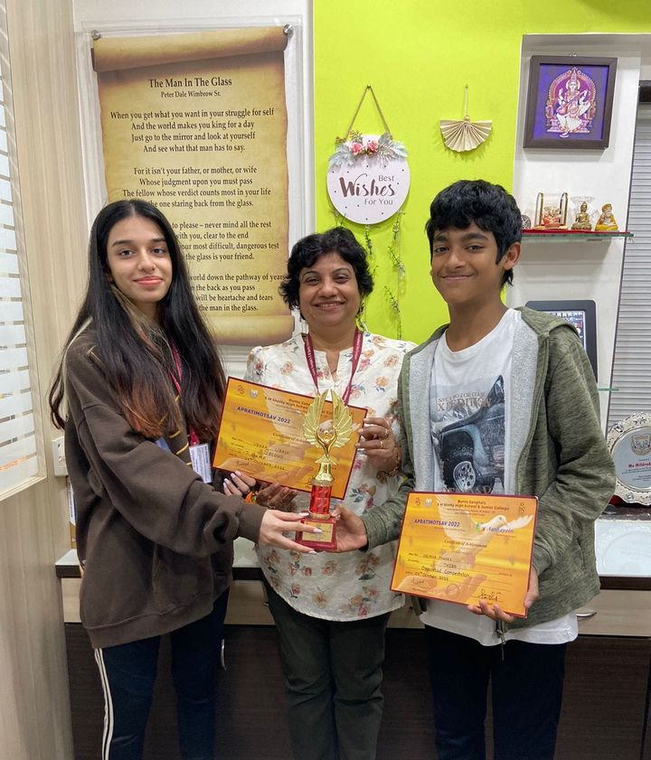
Glimpses of Apratimotsav Winners

Slide 11
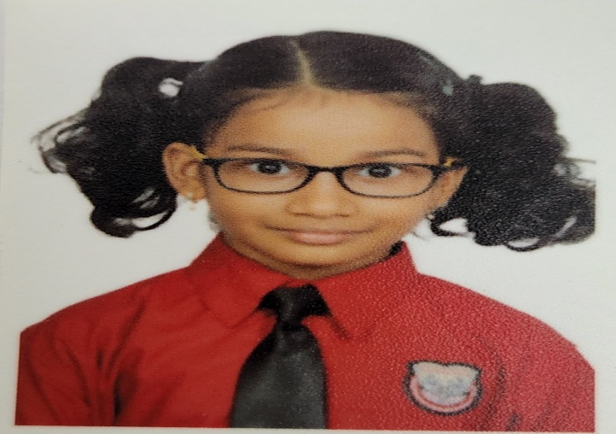
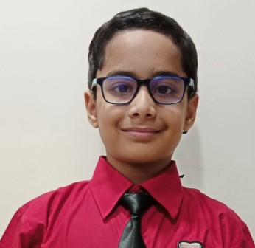
Vedanshi Ate and Abhir Ghalke from CP V have recorded a podcast session with the global kids podcast channel called 'What's new today',

Slide 12
Driti Sets A Record today as NOBLE WORLD RECORD HOLDER IN RUBICS CUBE

Slide 13
Joshua Fernandes for successfully completing Trinity Piano Exam for grade 8. He is one of the youngest to achieve this at the age of 12.

Slide 14
Master Janay Mukherjee of CP IV E won a gold medal in Velocity Competition for Abacus held in Kandivali

Slide 15
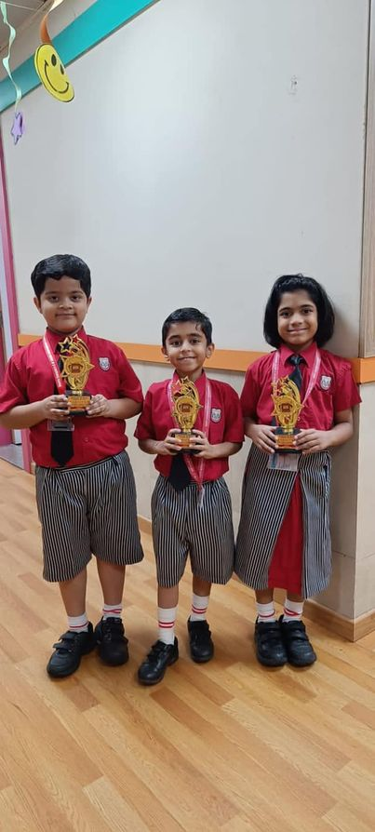
CP students Hridaya Shetty, Evan Amal, Jaksh Gada, and Ira Joshi won gold medals at the "Velocity Competition for Abacus" held in Kandivali.

Slide 16
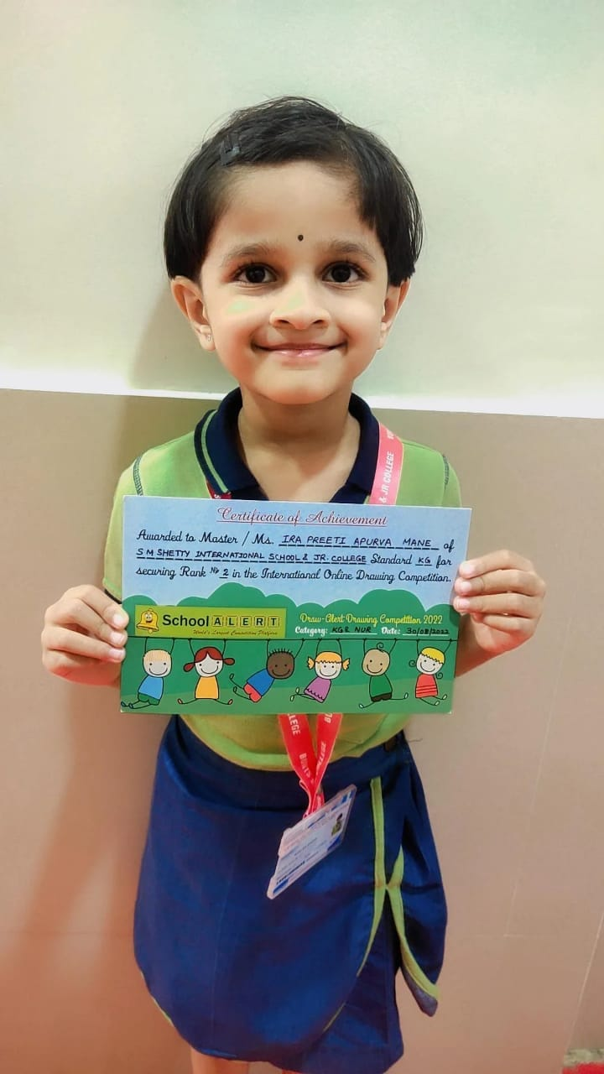
Ira Mane from IEYC III D won the Second position at the International Online Drawing Competition conducted by School Alerts

Slide 17
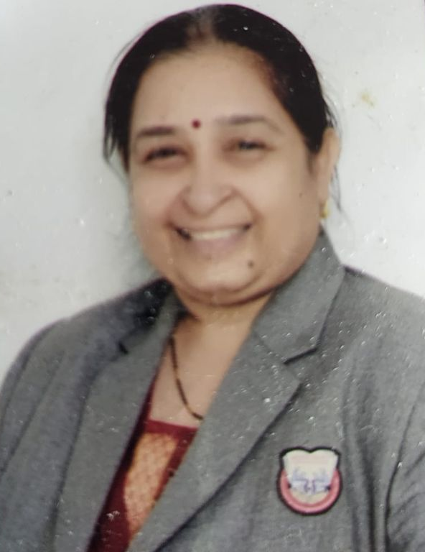
Ms Nilambari Kolwalkar, CP Coordinator participated in the International Teachers' Olympiad conducted by Suraasa and has excelled in this test and is placed in the Top 10, 92.64 percentile at the Global Level.

Slide 18
Our IGCSE school team won the first prize in the Tug of Words debate competition at JBCN. Team members - Aarush, Shresht, Sakshi and Aanya won all the first three preliminary rounds and the semi finals and the finals.

Slide 19
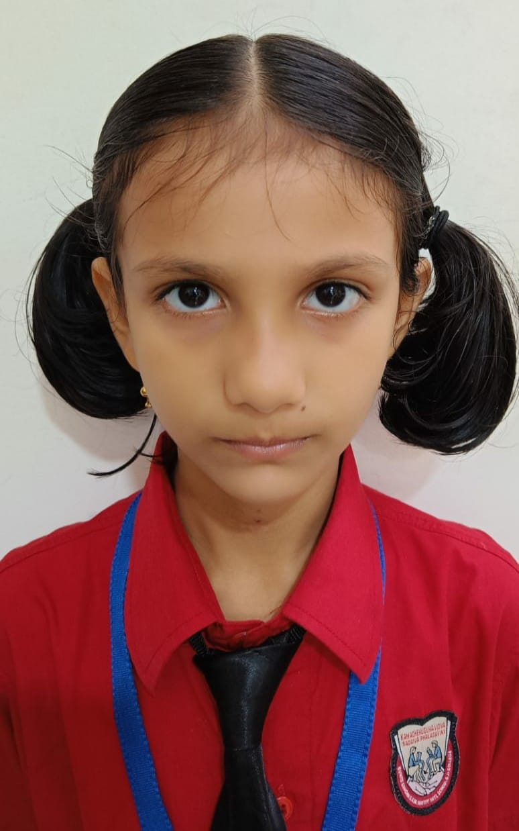
Miss Aarna Thakur studying in CP 2C participated in MSSA chess tournament and she ranked 22nd out of 80 girls and she played 7 games and won 4 out of them.

Slide 20
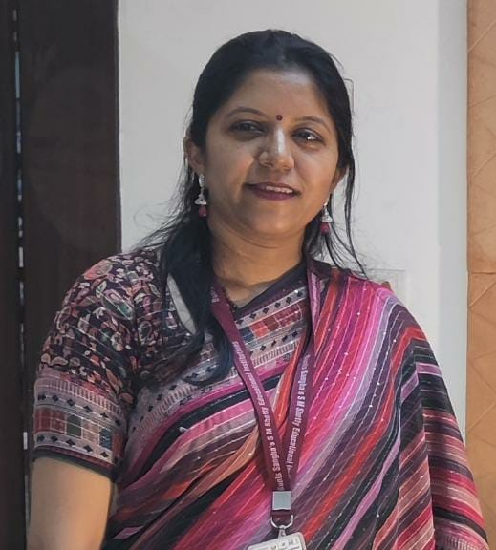
Our faculty Ms Nitya Chhatpar won the Best Formative assessment award in the TTF contest held across India by the teachers foundation organization

Slide 21
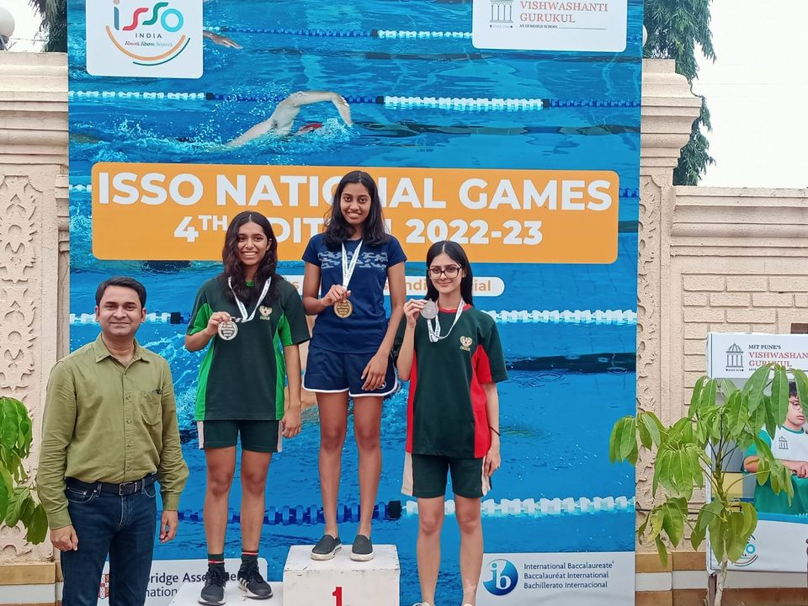
Riddhima Pradhan from IGCSE I has won accolades at the Cambridge International Schools Sports Organization (ISSO).She won the Gold medal in the 200m freestyle Girls category and won the Bronze in the 100m Breaststroke Girls category.

Slide 22
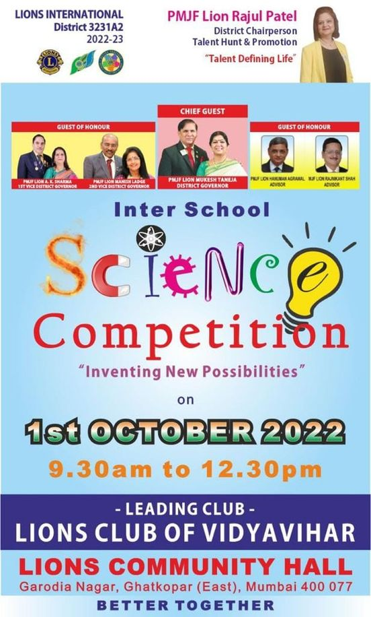
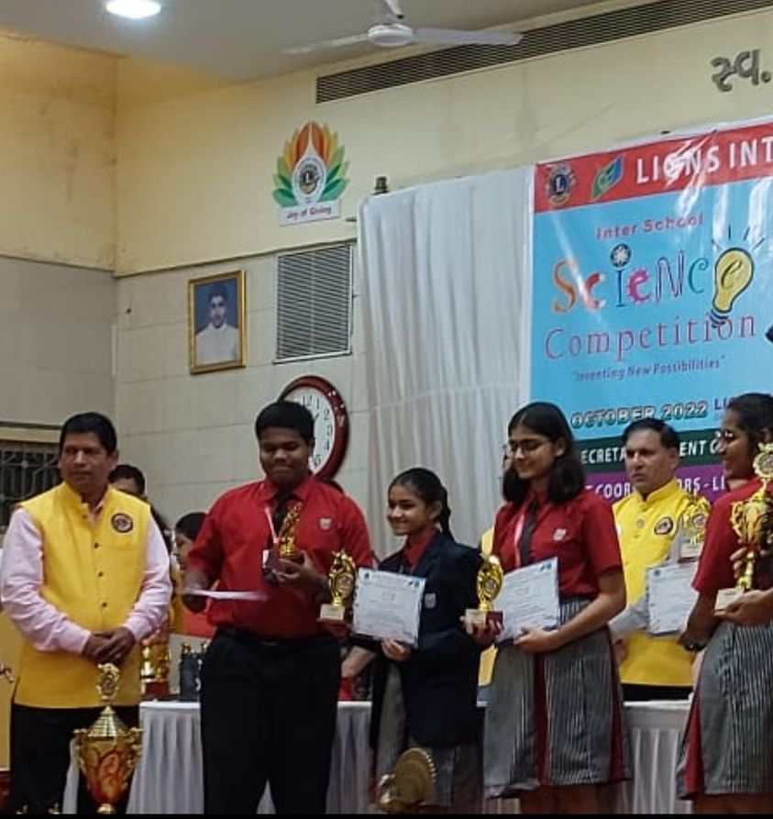
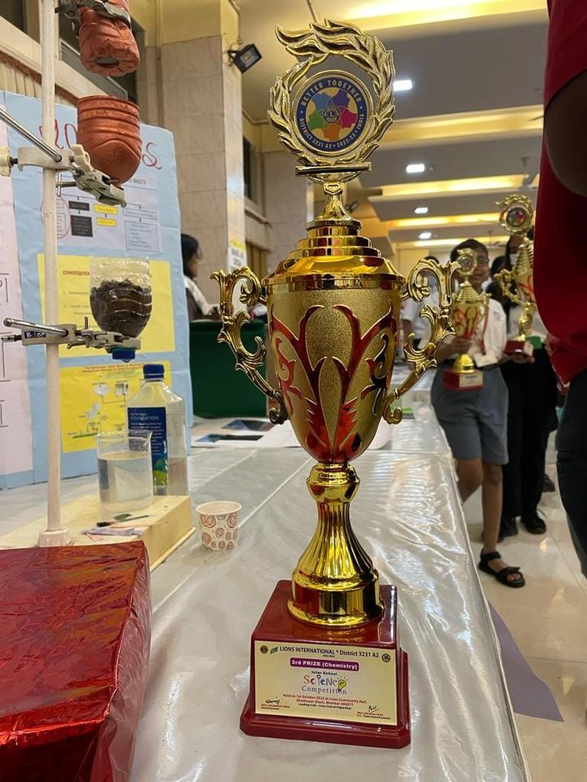
Our students Sarah Ann Menezes, Kiranmayee Lade, Divya Daga and Sanskar Nagral from IGCSE I won the third position at the Interschool Science Competition conducted by Lion's Club of Vidyavihar on 1st October in the Chemistry category mentored by our Chemistry faculty Ms. Vaishali Khedekar. They presented a WATER TREATMENT PROJECT for grey water management.

Slide 23
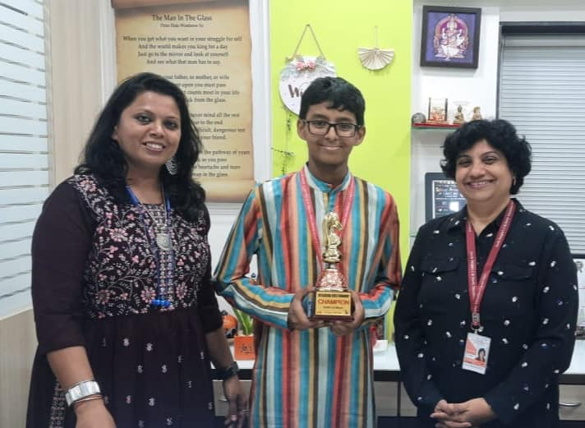
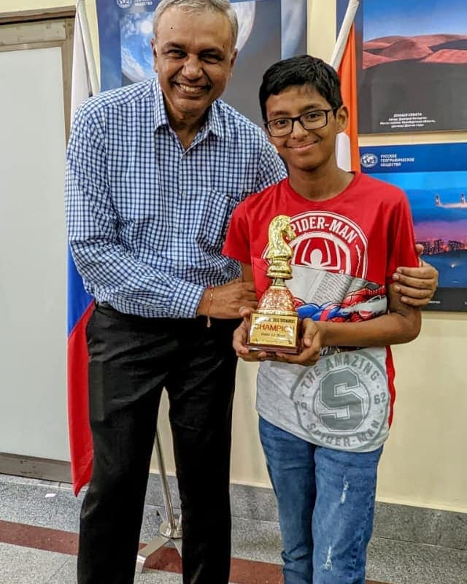
Checkpoint II student Ishan Roy won First prize in ICS classical tournament, U12 boys category and in 3 days classical chess tournament, he got 5.5/8. He also secured fifth place in Pinnacle Chess Fest 2022, August 28, 2022 under U-15 category. He has achieved the 9th position from among the 385 participants in the Mumbai Schools Sports Association under 14 Boys Chess Tournament.

Slide 24
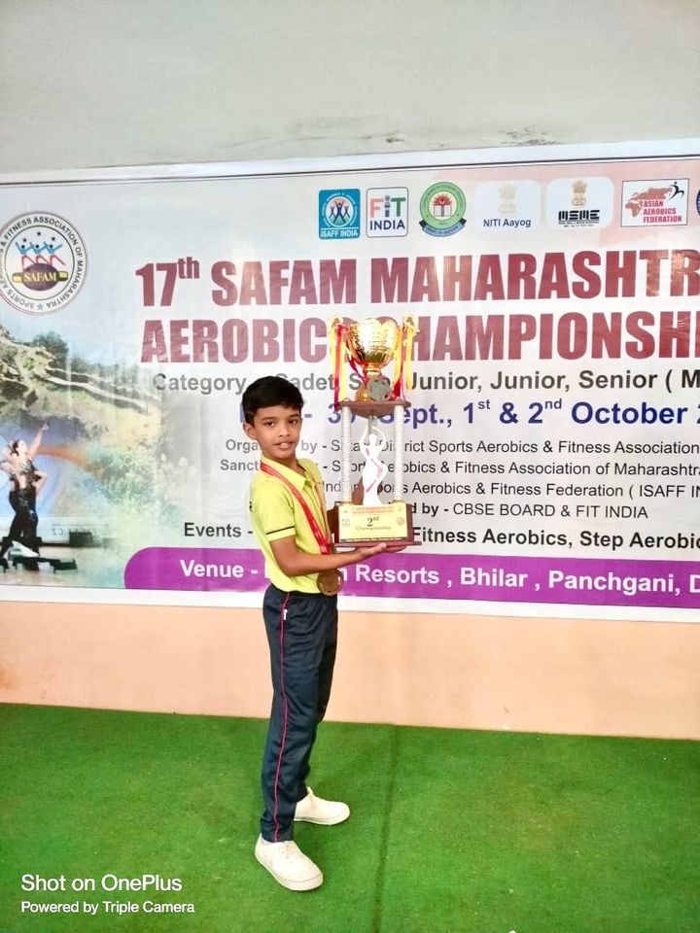
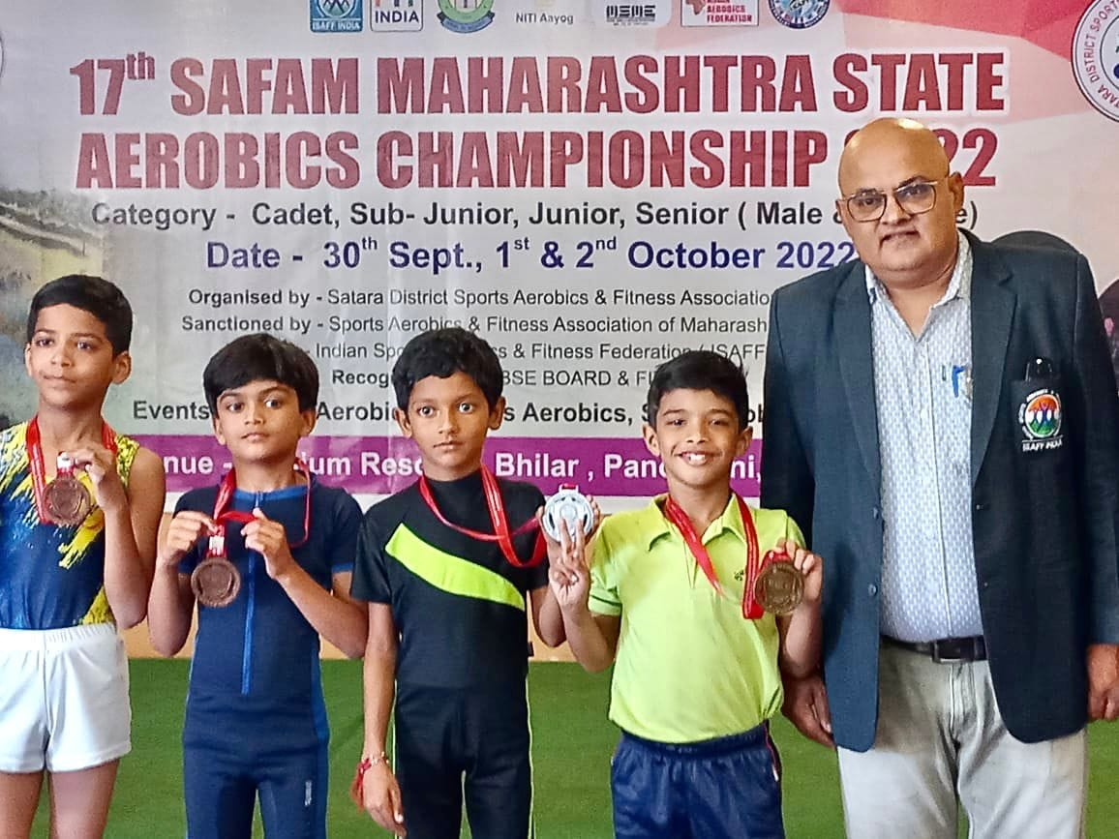
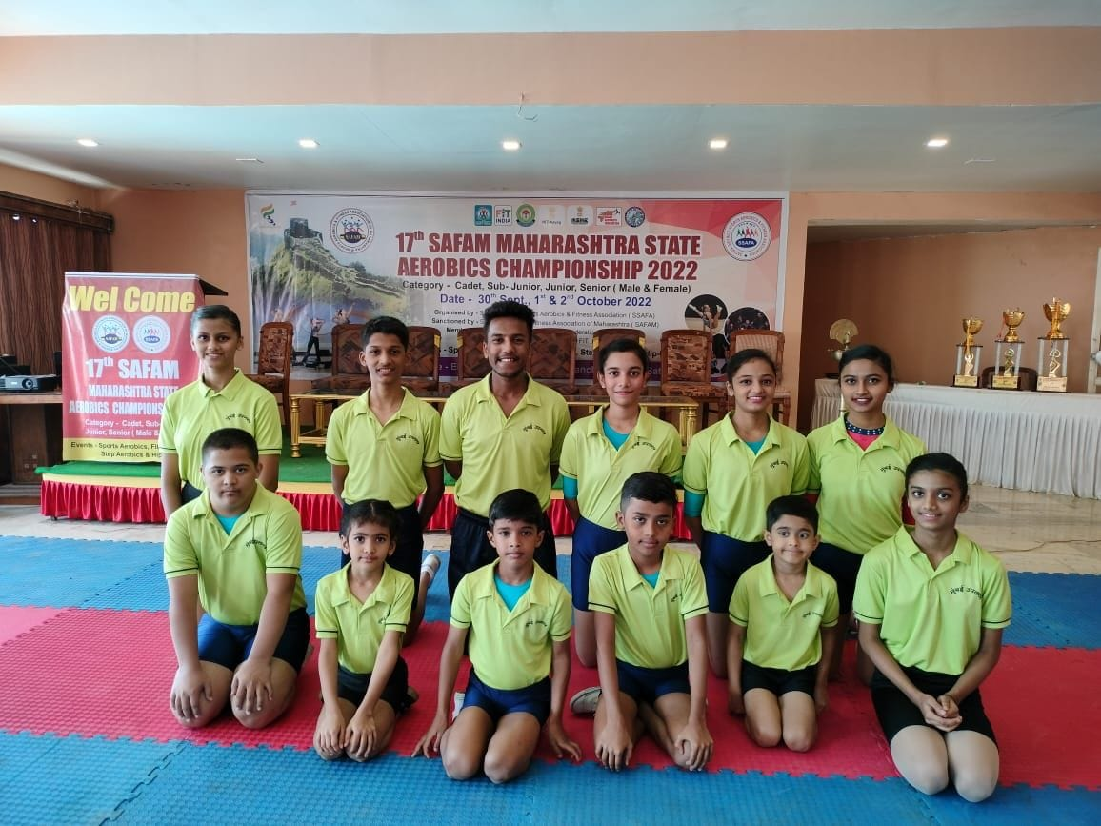
In 17th SAFAM Maharashtra State Aerobics Championship 2022 held in Bilhar Panchgani held from September 20 to October 2, 2022, our student Ayaan Ram participated in 4 events and won 4 Gold medal.

Slide 25
Our School is selected in the Top 5 school from 90+school across India. Sagarika Gupta won second position in 6th – 8th Grade in category of “Paint India” organized by FairGaze a colloboration between India and Bhutan

Slide 26
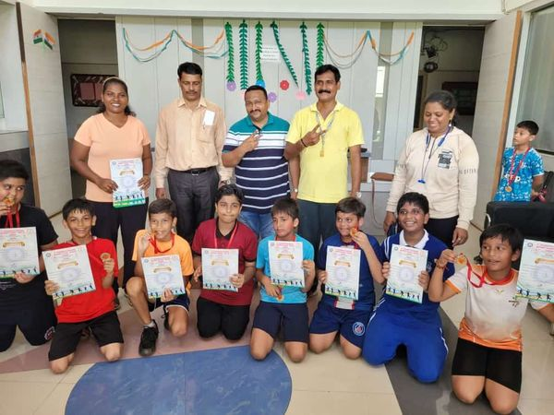
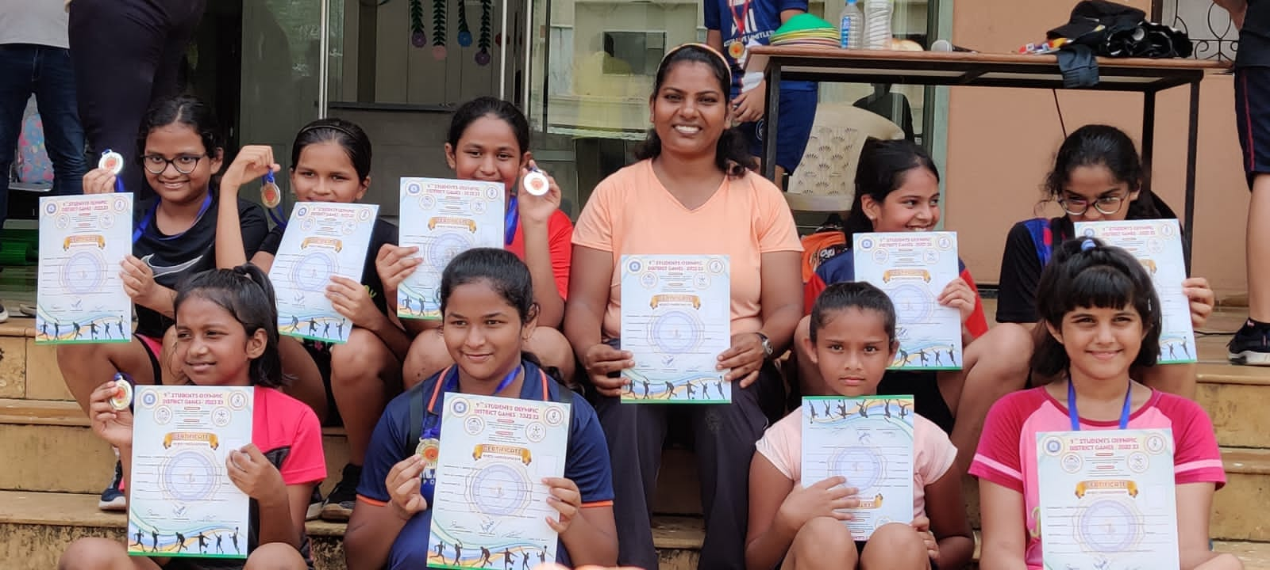
First place in the U12 Boys and second place in the U12 Girls Handball Tournaments organized by the DISTRICT OLYMPIC GAMES Competition & Selection Trials for 2022-2023

Slide 27
Handball Coach Ms. Rekha Kamble was felicitated by the Cabinet Minister Mr. Anurag Thakur for representing our country as the Captain of the Indian team at the Asian Beach Handball Tournament held in April 2022 in Thailand. Ms. Rekha has also represented the Indian team and the Maharashtra State team.

Slide 28
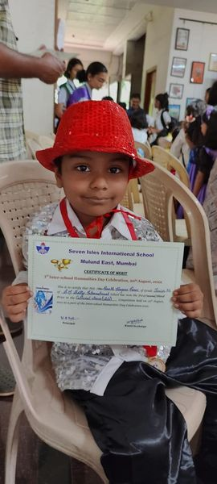
Yagna Palliwal and Yahvi Mange of IEYC III bagged third position in ACS fest hop2022-2023

Slide 29
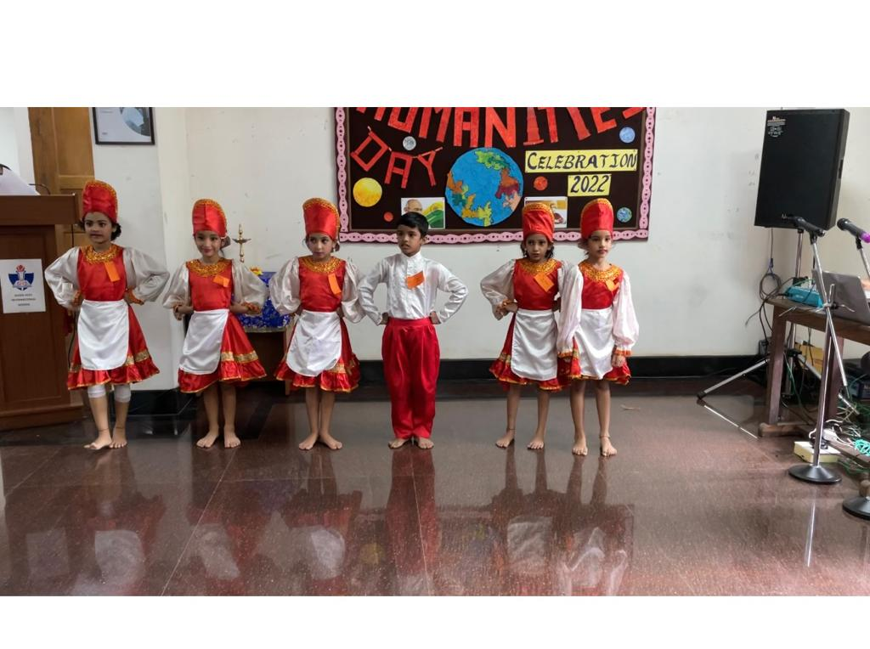
Our students won 6 awards at the “Interschool Humanities Day Celebration” held at Seven Isles School.

Slide 30
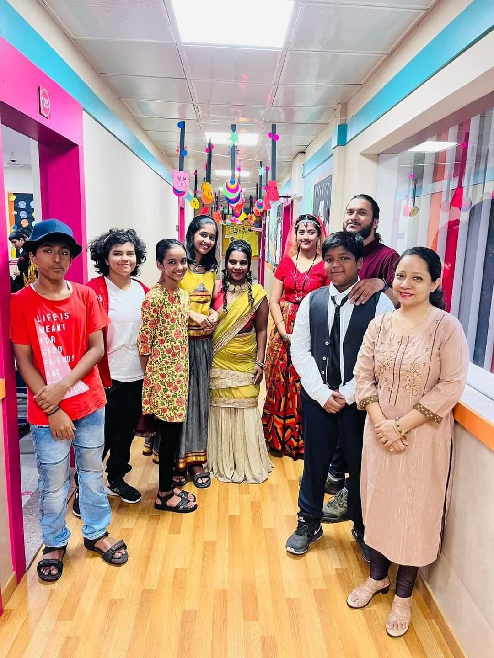
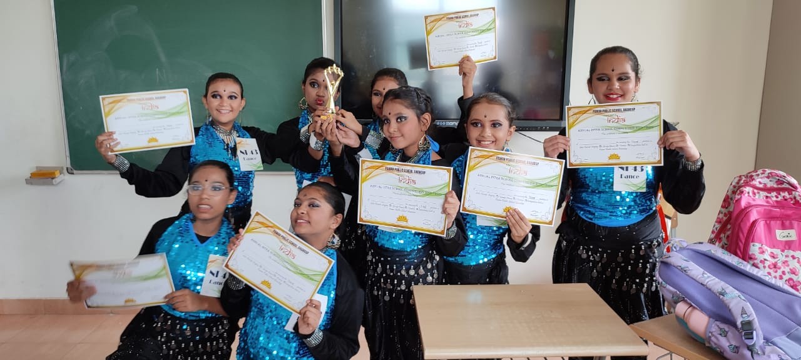
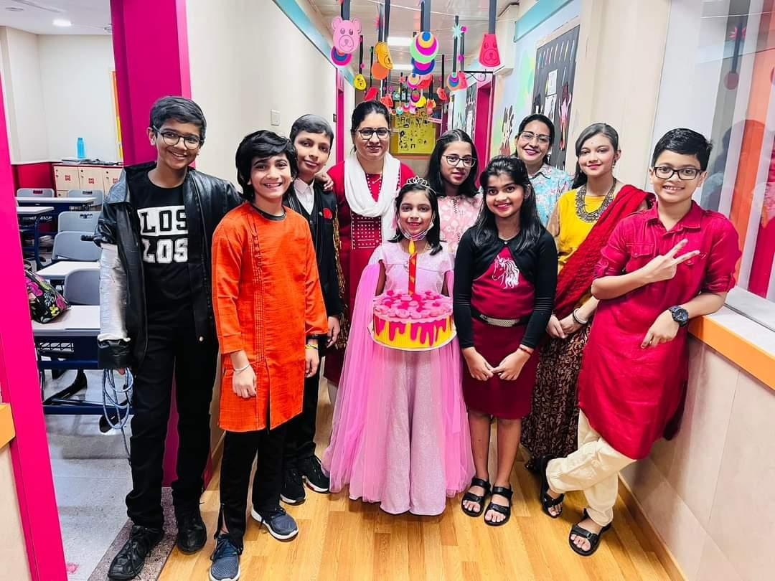
NAMASTE INDIA – 3rd position –Dance Competition

Slide 31
Ishan Roy of Checkpoint II D (Grade 7) secured fifth place in Pinnacle Chess Fest 2022, under U-15 category.

Slide 32
Students and teachers were felicitated by Rotary club for their outstanding performance in the board years. Ms Tahira Pasha, Ms Jolly Francis and Mr Gurvinder Singh were honoured for their contribution to student performance and development.

Slide 33
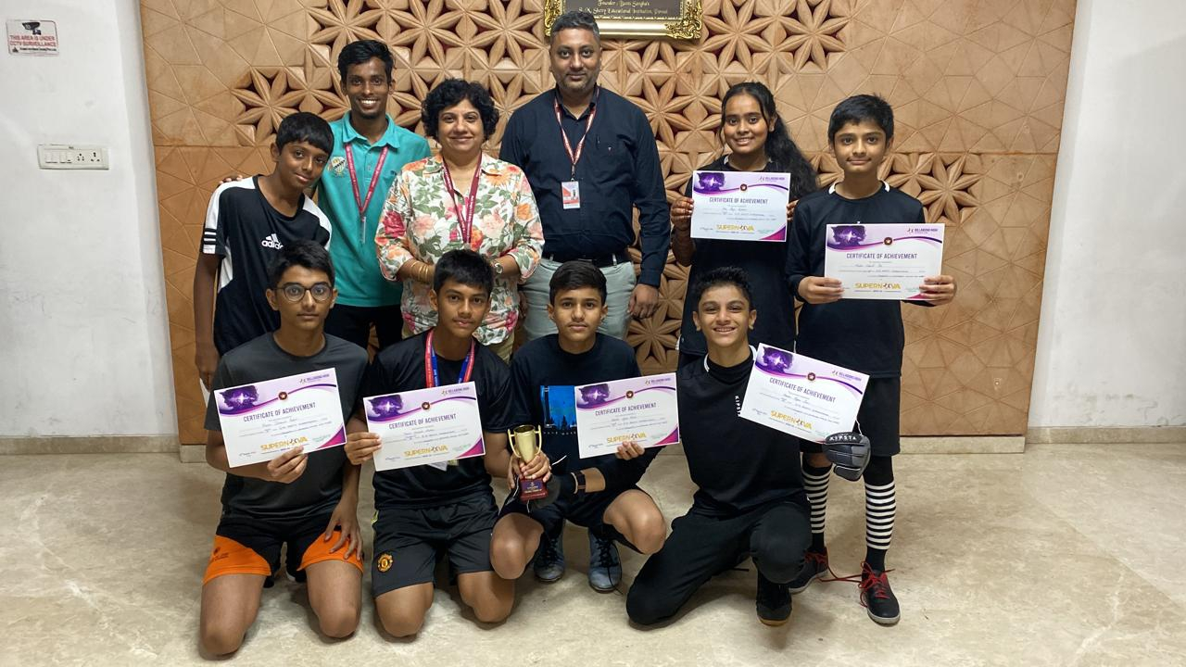
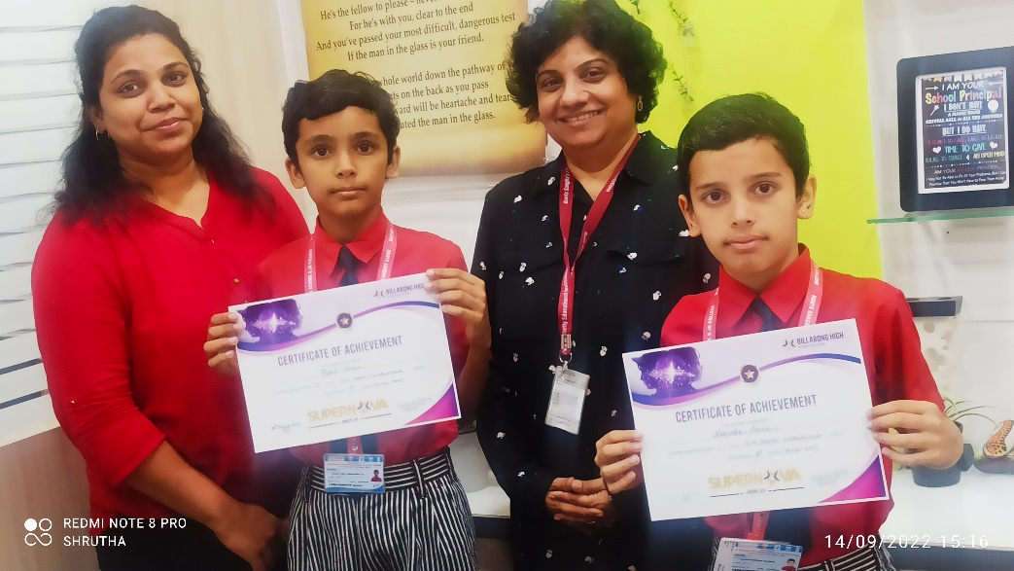
Supernova Sports Competition at Billabong, Juhu

Slide 34
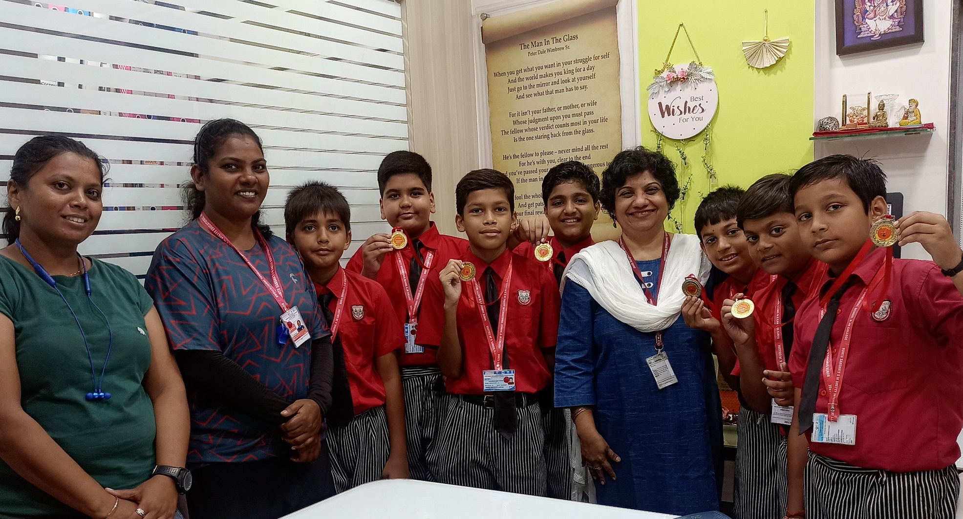
Supernova Sports Competition at Billabong, Juhu

Slide 35
Principal Ms. Mildred Lobo has successfully completed the training program IMC RBNQA - Certied Examiner for Quality Management She has also been elected as the MISA Executive Committee member for the academic year 2022.

Slide 36
Ms Huzaifah Bhaldar has officially been welcomed as a 2022 Climate Action Project Facilitator! She will join a global team of about 120 facilitators to share her expertise and provide facilitation to teachers participating in the Climate Action Project 2022.

Slide 37
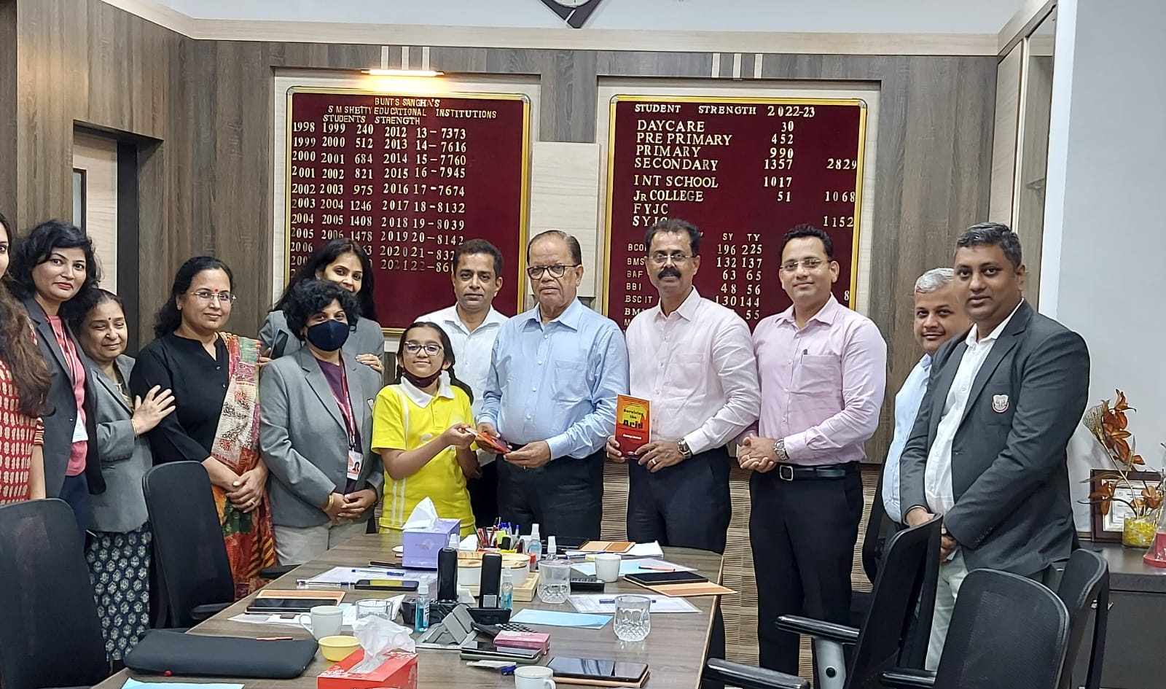
Ananya Harish, a budding author had her first book launched on Sunday, 3rd July.

Slide 38
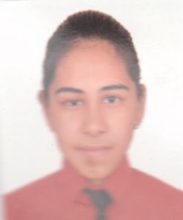
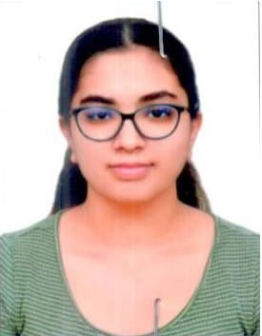
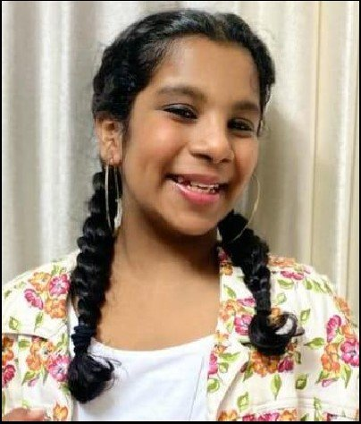
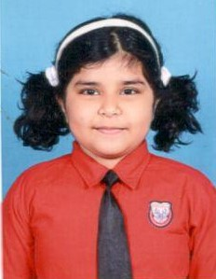
Aarush Bathula, Vaanya Sharma, Trisha Saini, Om Menon, Megan Salian are the winners at Fairgaze MUN

Slide 39
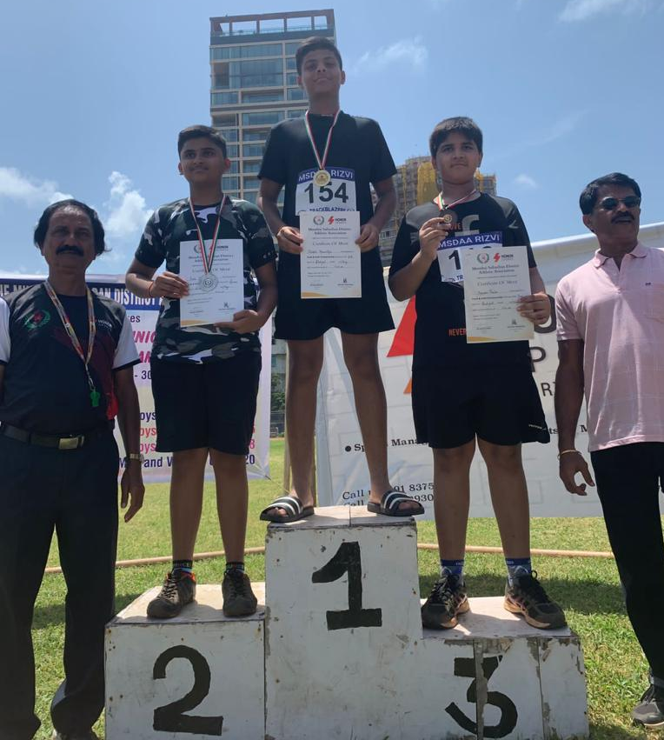
In the Athletics Competition organized by MSDAA (Mumbai Suburban District Athletic Association) on July 30th and 31st, 2022, Harshil Khanvilkar , Checkpoint III (Grade 8) student secured two Gold Medals in Ball Throw and in Shot Put.

Slide 40
In the Athletics Competition organized by MSDAA (Mumbai Suburban District Athletic Association) on July 30th and 31st, 2022, Mahi Shukla, AS level student secured bronze medal in Discus throw

Slide 41
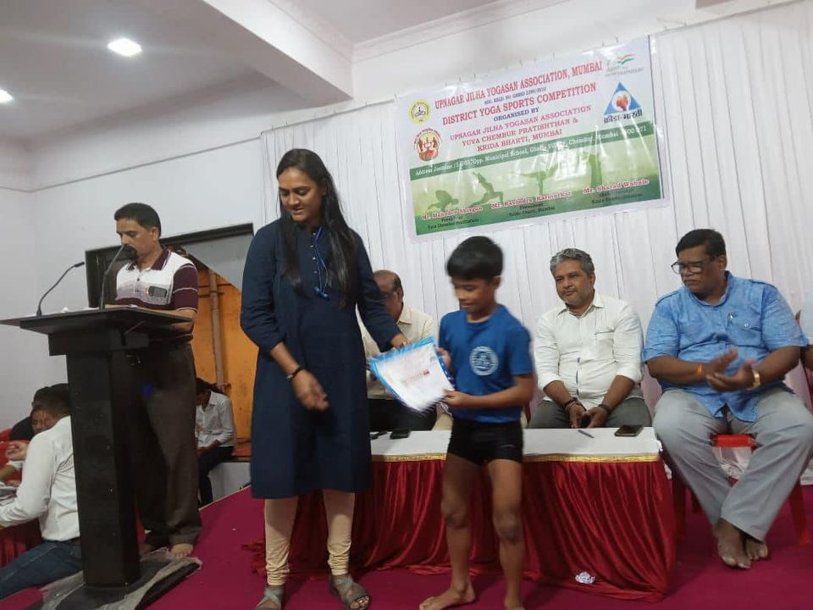
Ayaan Ram, CP III (Grade3) student, achieved 4th position in District Yoga Sports Competition organized by Upnagar Jilha Yogasan Association, Mumbai.

